Slide 1
PRESENTATION ON UNITED NATIONS
NAME: S.M. TASNIMUL HASAN
ID: 18.02.04.142
SECTION: B
GROUP: B2

Slide 2
CONTENTS
History of the United Nations
Leaders
Objectives of the UN
Five Permanent Members of the UN
Six Principal Organs of the UN
Official Languages of the UN
Specialized Agencies of the UN
Secretary-Generals of the UN
UN Successes

Slide 3

Flag of the United Nations

Slide 4
History of the United Nations
Founded: October 24, 1945, San Francisco, California, United States
Headquarters: New York City, New York, United States
Members when founded: 51 Member States
Members now: 193 Member States & 2 Observer States

Slide 5
Leaders
Secretary-General : Antonio Guterres
Deputy Secretary-General : Amina Jane Mohammed
General Assembly President : Maria Fernanda Espinosa
Economic and Social Council President : Inga Rhonda King
Security Council President : Francois Delattre

Slide 6
Objectives of the United Nations
To maintain international peace and security
To develop friendly relationships among nations
To cooperate in solving international problems
To promote human rights
To be a centre for helping nations
To respect the principle of equal rights

Slide 7





Five Permanent Members of UN

Slide 8
Six Principal Organs of UN
General Assembly
Security Council
Economic and Social Council
Trusteeship Council
International Court of Justice
UN Secretariat

Slide 9
Official Languages of UN
Arabic
Chinese
English
French
Russian
Spanish

Slide 10
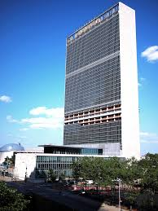
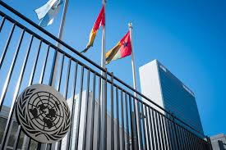
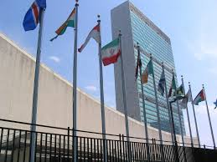
UN Secretariat

Slide 11
Specialized Agencies of the UN
At present the UN has in total 15 specialized agencies that carry out various functions on behalf of the UN. The specialized agencies are listed below.
Food and Agriculture Organization (FAO)
International Civil Aviation Organization (ICAO)
International Fund for Agricultural Development (IFAD)
International Labour Organization (ILO)
International Maritime Organization (IMO)

Slide 12
Specialized Agencies of the UN
International Monetary Fund (IMF)
International Telecommunication Union (ITU)
United Nations Educational, Scientific and Cultural Organization (UNESCO)
United Nations Industrial Development Organization (UNIDO)
Universal Postal Union (UPU)

Slide 13
Specialized Agencies of the UN
World Bank Group (WBG)
World Health Organization (WHO)
World Intellectual Property Organization (WIPO)
World Meteorological Organization (WMO)
World Tourism Organization (UNWTO)

Slide 14
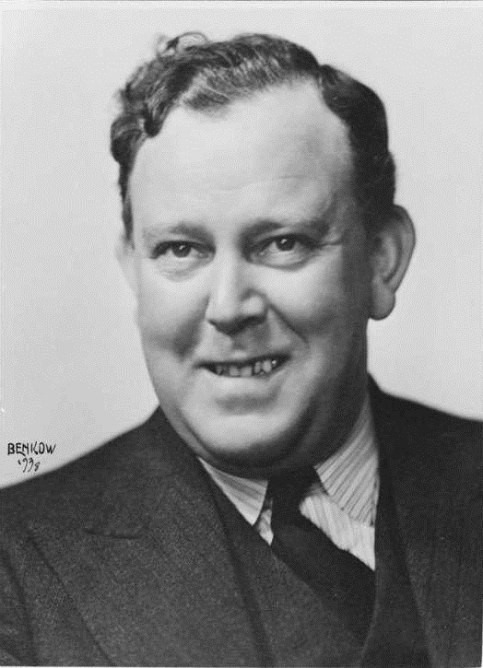
Does anybody know this person?

Slide 15

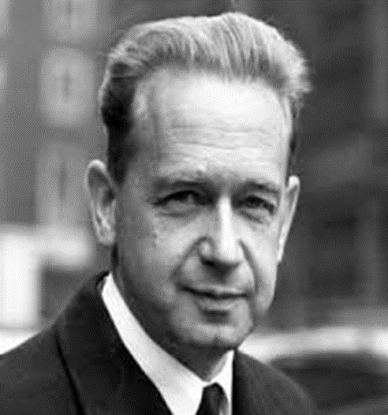
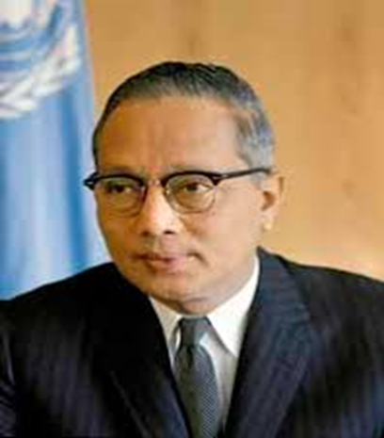
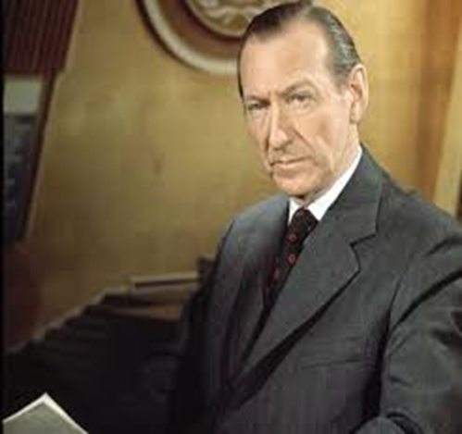
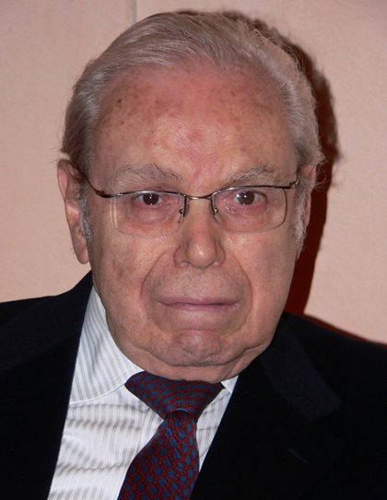
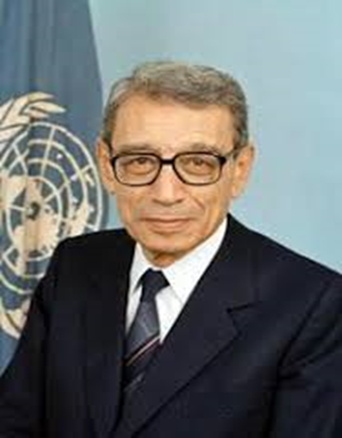
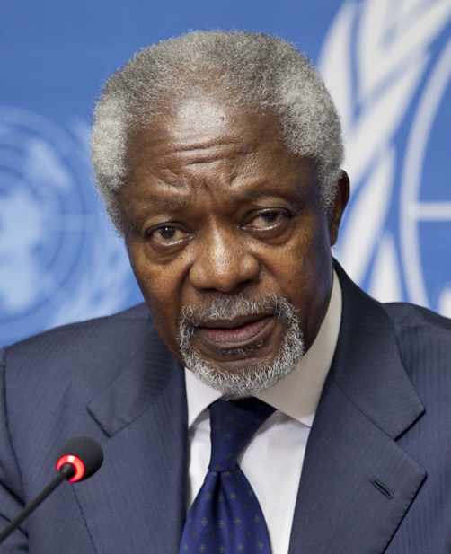
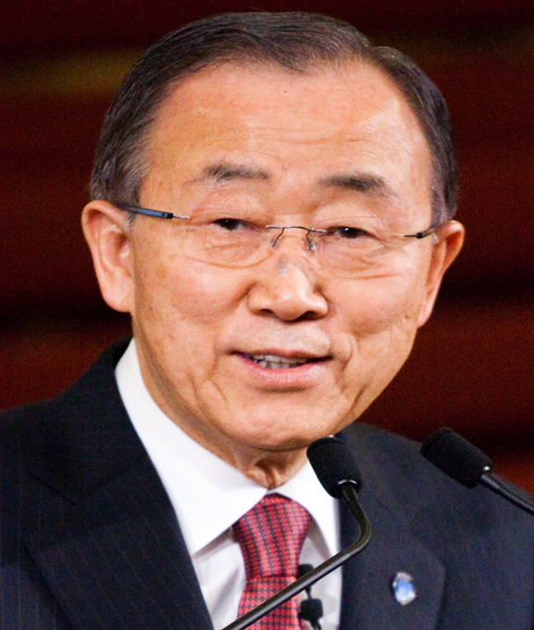
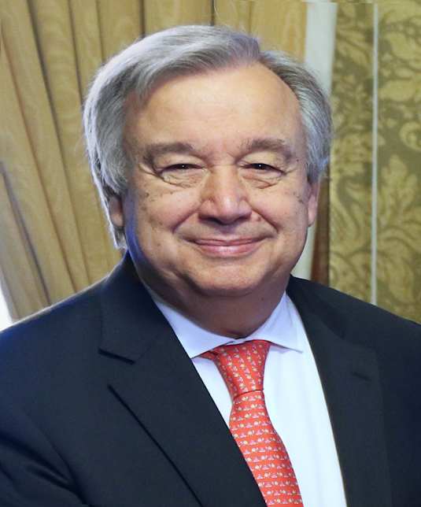
Secretary-Generals of the UN

Slide 16
Trygve Lie
1st Secretary-General of the United Nations
2 February 1946 – 10 November 1952
From- Norway

Slide 17

Dag Hammarskjöld
2nd Secretary-General of the United Nations
10 April 1953 – 18 September 1961
From- Sweden

Slide 18

U Thant
3rd Secretary-General of the United Nations
30 November 1961 – 31 December 1971
From- Burma (Myanmar)

Slide 19

Kurt Waldheim
4th Secretary-General of the United Nations
1 January 1972 – 31 December 1981
From- Austria

Slide 20

Javier Pérez de Cuéllar
5th Secretary-General of the United Nations
1 January 1982 – 31 December 1991
From- Peru

Slide 21

Boutros Boutros-Ghali
6th Secretary-General of the United Nations
1 January 1992 – 31 December 1996
From- Egypt

Slide 22
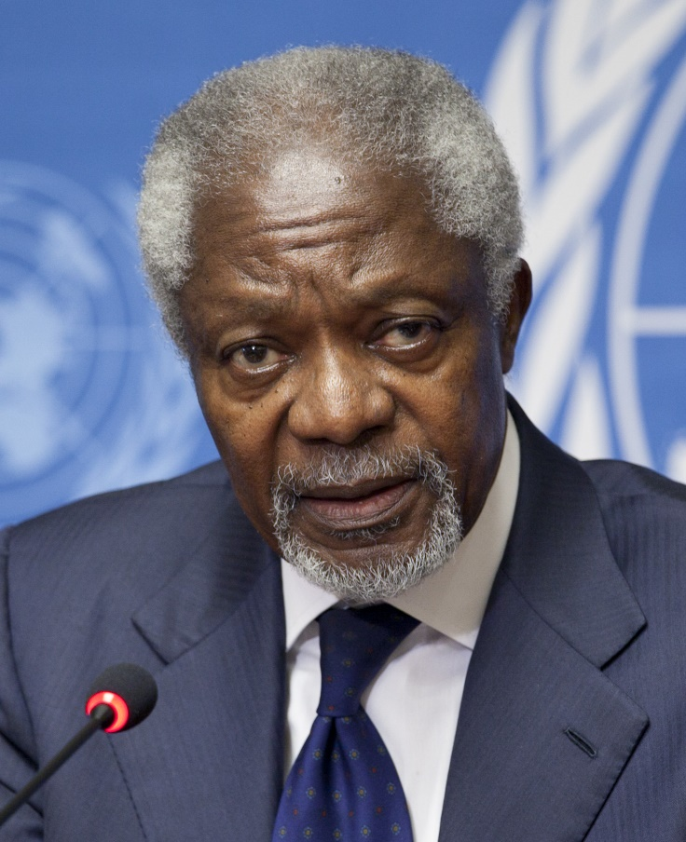
Kofi Annan
7th Secretary-General of the United Nations
1 January 1997 – 31 December 2006
From- Ghana
Died- 18 August 2018 (aged 80) Bern, Switzerland

Slide 23

Ban Ki-moon
8th Secretary-General of the United Nations
1 January 2007 – 31 December 2016
From- South Korea

Slide 24

António Guterres
9th & Present Secretary-General of the United Nations
1 January 2017-
From- Portugal

Slide 25
UN Successes
Since its inception, the United Nations has performed numerous humanitarian, environmental and peace-keeping undertakings, including:
Providing food to 90 million people in over 75 countries
Assisting more than 34 million refugees
Authorizing 71 international peacekeeping missions
Working with 140 nations to minimize climate change
Protecting human rights with 80 treaties and declarations

Slide 26
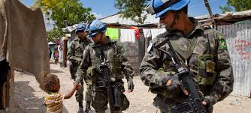
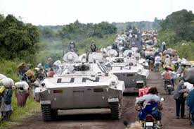
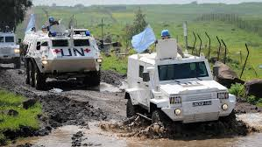
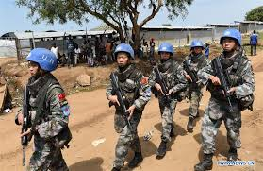
UN Peacekeeping Missions

Slide 27

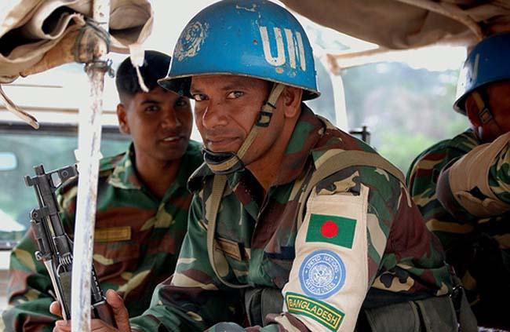
Bangladesh in UN Peacekeeping Missions

Slide 28
References
https://www.un.org/en/
https://www.un.org/en/about-un/
https://en.m.wikipedia.org/wiki/United_Nations
https://en.m.wikipedia.org/wiki/History_of_the_United_Nations
https://en.m.wikipedia.org/wiki/Secretary-Generals_of_the_United_Nations

Slide 29

Any Question ?

Slide 30
Thank You

